Slide 1
Electrical
To supply power to the whole robot
locomotion and wall clinging mechanism of the robot
Manual path trajectory and path planned trajectory
Feedback from sensors

Slide 2
Battery
Actuators
Raspberry Pi
ESC
NodeMCU
Motor Driver
Camera
EDF + Motor
Receiver
Gear Motor

Slide 3
Negative Thrust
The base concept of Negative Thrust is to create a partial vacuum while sucking the air.
An EDF along with a motor will be fitted at the center of the robot.
This will create a negative thrust and keep the robot connected to the wall.

Slide 4
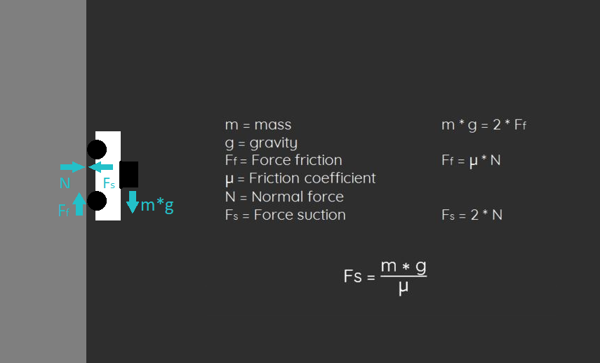

Slide 5
Kinematic Motion
We are making a 4 wheeled robot with each wheel having a hub mounted motor.
All the motors have independent motion from each other, but the collective motion drives the robot.
Based on this, we will use the differential wheel turning method to steer our robot.

Slide 6
INSERT DIAGRAM

Slide 7
Positioning
An accelerometer is a sensor that measures the acceleration.
Double integration of the measured acceleration will give us the displacement.
Using displacement MCU can determine the exact location of the wall traversing robot in XYZ plane w.r.t starting point.

